Slide 1



STRAIGHT TALK ON CONTENTMENT
1 Corinthians 7:1-24
Dr. Rick Griffith • Crossroads International Church Singapore
cicfamily.com & BibleStudyDownloads.org

Slide 2

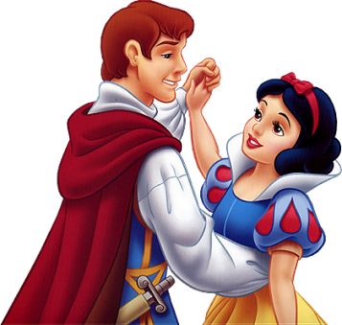
Black

Slide 3
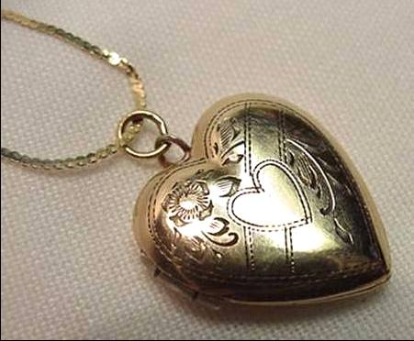
“You never know true happiness until you're married…”
“… and then it's too late!”

Slide 4
Black

Slide 5

Are you content?

Slide 6

Why should you be content with your…?
  • marital state?
  • body (physical appearance)?
  • job (social standing)?

Slide 7
The Wayward Local Church
The Wayward Local Church
Reports
Questions
Division
Disorder
Difficulties
Concern
1–4
Discipline
5–6
Instruction
7–16
Carnality
3–4
Marriage 7
Worship
11–14
Factions 1–2
Incest 5
Idols 8–10
Resurrection
15
Immorality
Collection 16
Lawsuits 6
Solving church problems theologically

Slide 8

1 Corinthians 7 Overview
“Remain”
17, 20, 24
Marriage
7:1-24
Singleness
7:25-40

Slide 9
1 Corinthians 7 Main Idea
Marriage, a new physical appearance or work status won’t make you happy—but being content with the state God placed you will!

Slide 10
1 Corinthians 7 Overview
“Remain”
17, 20, 24
Marriage
7:1-24
Singleness
7:25-40

Slide 11
Black

Slide 12
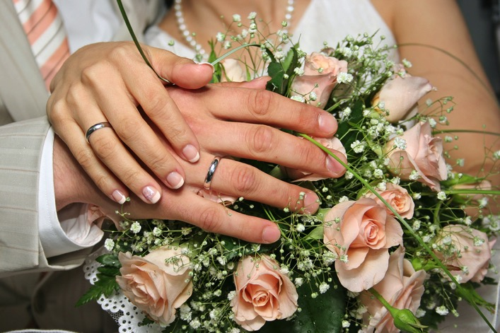
I. Those married can have their sexual needs legitimately met (1-7)

Slide 13
Black

Slide 14
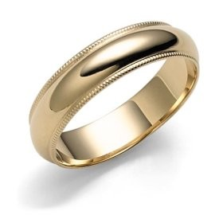
“The wedding ring is that small piece of jewelry placed on the finger that cuts off your circulation”

Slide 15
Black

Slide 16
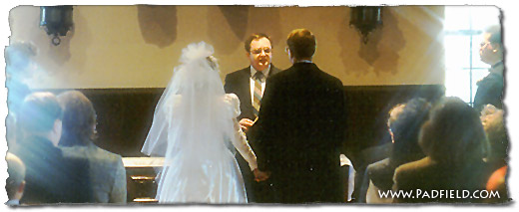
II. Widowers and widows can remarry if they have unmet sexual needs (8-9)

Slide 17
Black

Slide 18
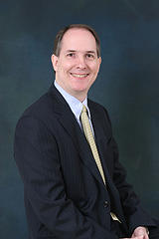
Dr. Walter McConnell

Slide 19
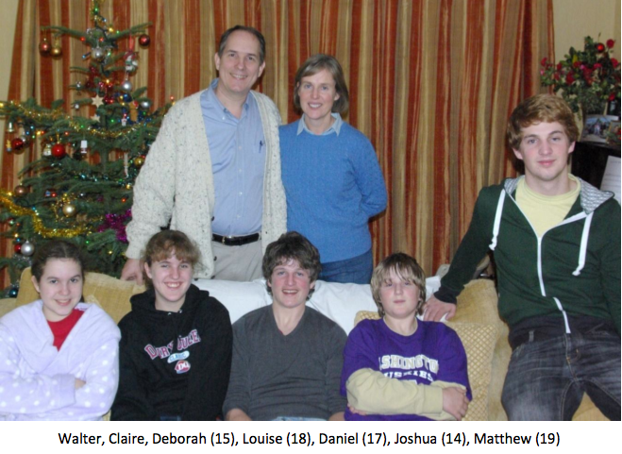
Walter & Claire McConnell

Slide 20
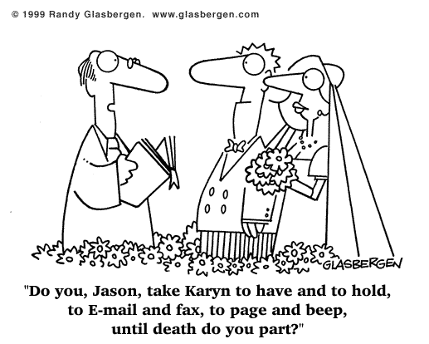
Black
"Do you, Walt, take Claire, to have and to hold, to email and facebook, to Tweet, Skype & text, until death do you part?"

Slide 21
Black

Slide 22


III. Divorcees should remain unmarried to enable reconciliation with their spouse (10-11)

Slide 23

Pamela Anderson

Slide 24
Black

Slide 25


Four Views…
1. No divorce, no remarriage
2. Divorce, no remarriage
3. Both divorce & remarriage after adultery or desertion
4. Both divorce & remarriage after various circumstances

Slide 26
Black

Slide 27
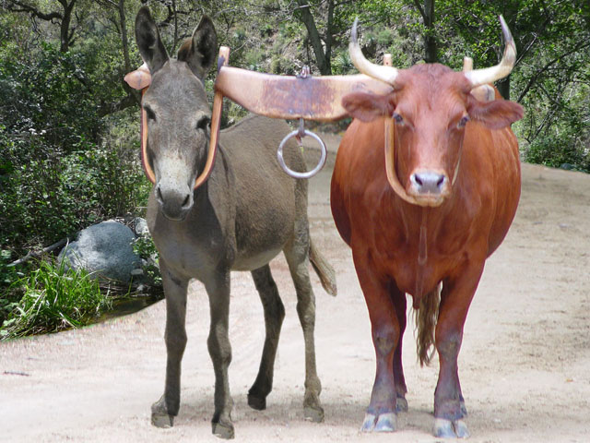
"Do not be yoked together with unbelievers" (2 Cor. 6:14 NIV)

Slide 28
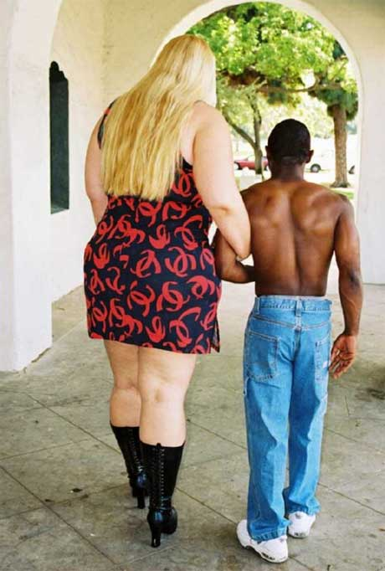
IV. Those in mixed marriages should stay married to be a godly influence in the family (12-16)

Slide 29
Black

Slide 30
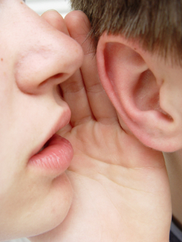
V. All of Us: Be content with your body and job (17-24)

Slide 31
Black

Slide 32
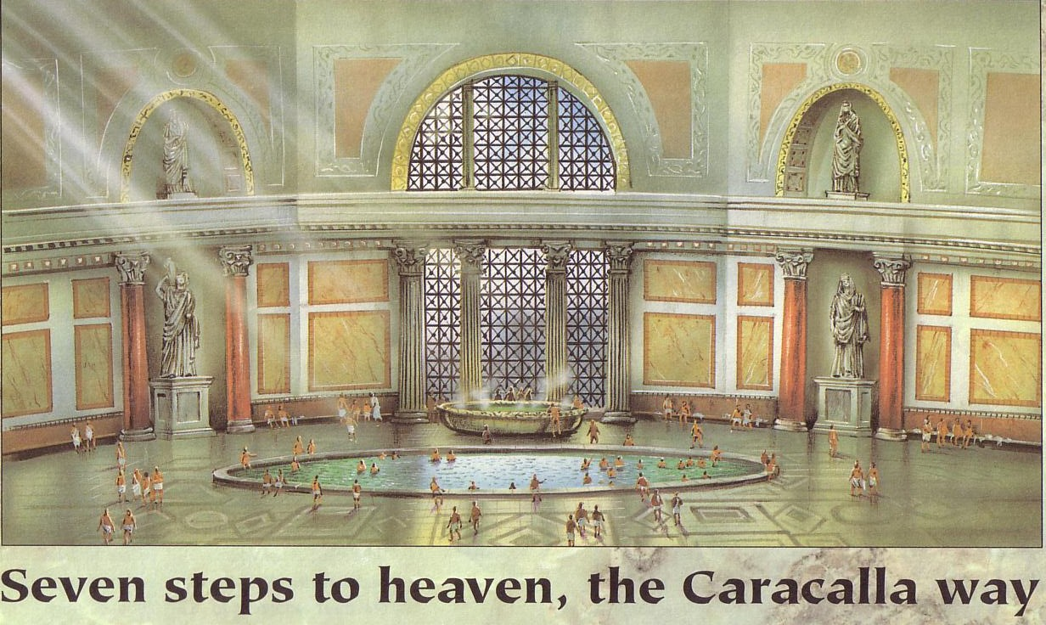
The Caracalla: Roman Luxury

Slide 33

Body Contentment (7:17-19)

Slide 34
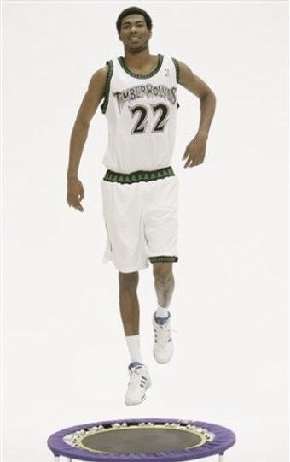
Trampoline

Slide 35
Black

Slide 36
Be content with your low socio-economic position (20-23)

Slide 37
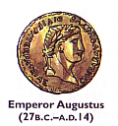

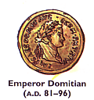
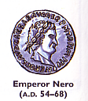
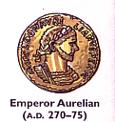

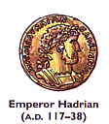
Four Roman Social Classes
98
Equestrians (Patricians)
Plebians
Freedman
Slaves

Slide 38
Black

Slide 39

Verse 24 Summary
Be content with the marital, physical, or socio-economic state God placed you.
But WHY?

Slide 40
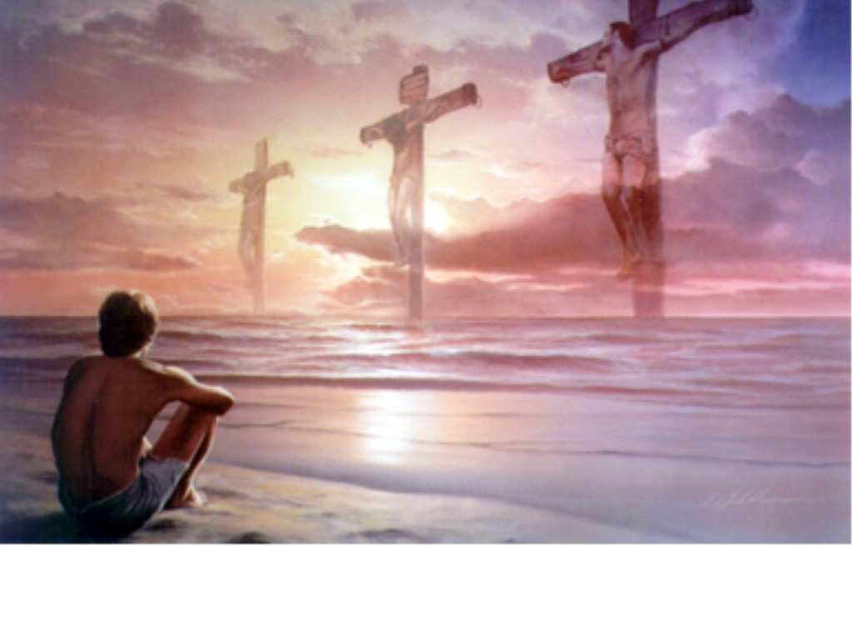
Main Idea
Be content with your marital state, body, and job because each situation has its advantages

Slide 41

Advantages
Marriage: intimacy
Singleness: ministry
Mixed Marriage:
mission field
Divorcees:
see God work
Undesirable Body: obedience
Less Money:
freedom in Christ

Slide 42

Contentment
“…is not the fulfillment of
what you want,
but the realization of
what you already have”

Slide 43
Black

Slide 44


NT Preaching link at BibleStudyDownloads.org
Get this presentation and script for free!
Notes:
NT Preaching (np)

